Slide 1

Read from files
Week 5

Slide 2
Explanation: Reading and Writing to text files in Python
Python provides inbuilt functions for creating, writing and reading files.
There are two types of files that can be handled in python, normal text files and binary files
Text files: In this type of file, Each line of text is terminated with a special character called EOL (End of Line), which is the new line character (‘\n’) in python by default.
Binary files: In this type of file, there is no terminator for a line and the data is stored after converting it into machine understandable binary language.

Slide 3
File Access Modes
Read Only (‘r’) : Open text file for reading. The handle is positioned at the beginning of the file. If the file does not exists, raises I/O error. This is also the default mode in which file is opened.
Read and Write (‘r+’) : Open the file for reading and writing. The handle is positioned at the beginning of the file. Raises I/O error if the file does not exists.
Write Only (‘w’) : Open the file for writing. For existing file, the data is truncated and over-written. The handle is positioned at the beginning of the file. Creates the file if the file does not exists.
Write and Read (‘w+’) : Open the file for reading and writing. For existing file, data is truncated and over-written. The handle is positioned at the beginning of the file.
Append Only (‘a’) : Open the file for writing. The file is created if it does not exist. The handle is positioned at the end of the file. The data being written will be inserted at the end, after the existing data.
Append and Read (‘a+’) : Open the file for reading and writing. The file is created if it does not exist. The handle is positioned at the end of the file. The data being written will be inserted at the end, after the existing data.

Slide 4
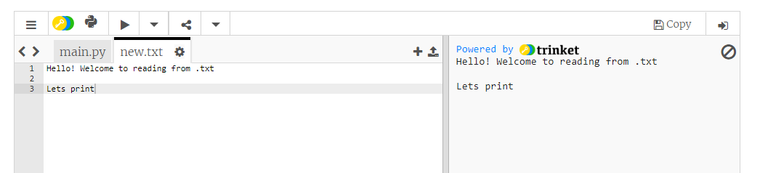
Open this web trinket reader: https://trinket.io/python3

Slide 5
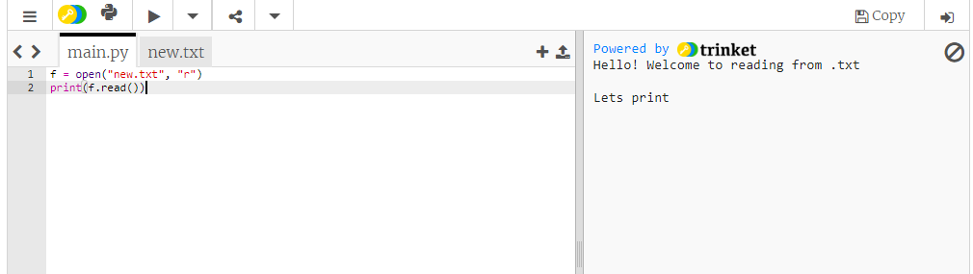
Create a read

Slide 6
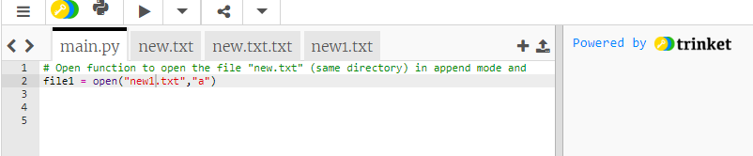
Opening a File

Slide 7
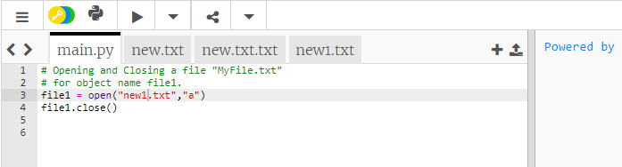
Closing a file

Slide 8
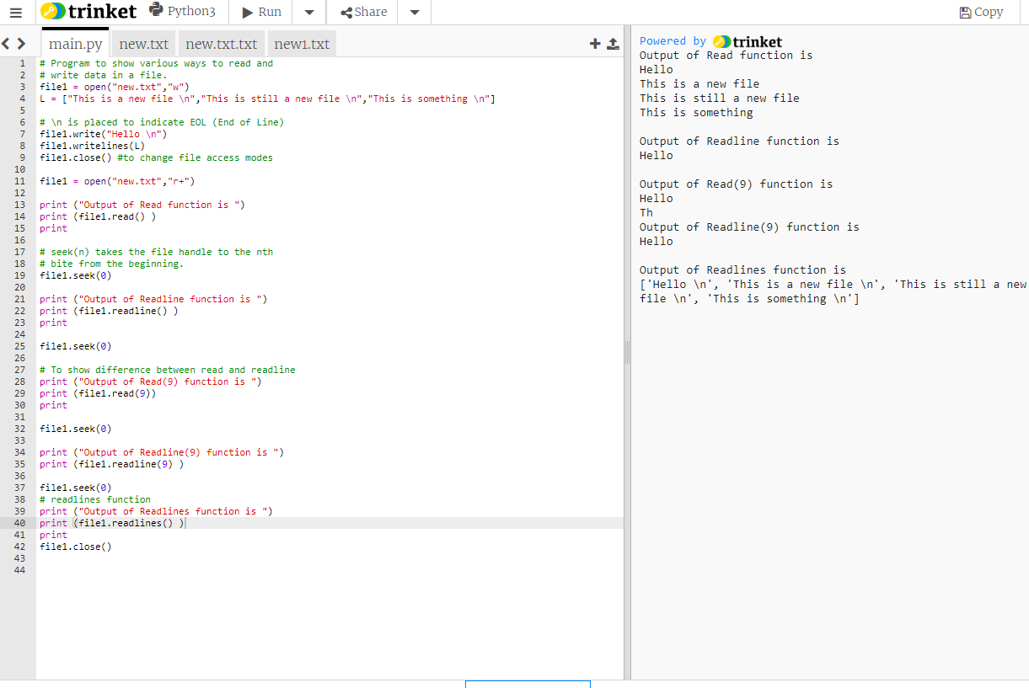
Writing to a file

Slide 9
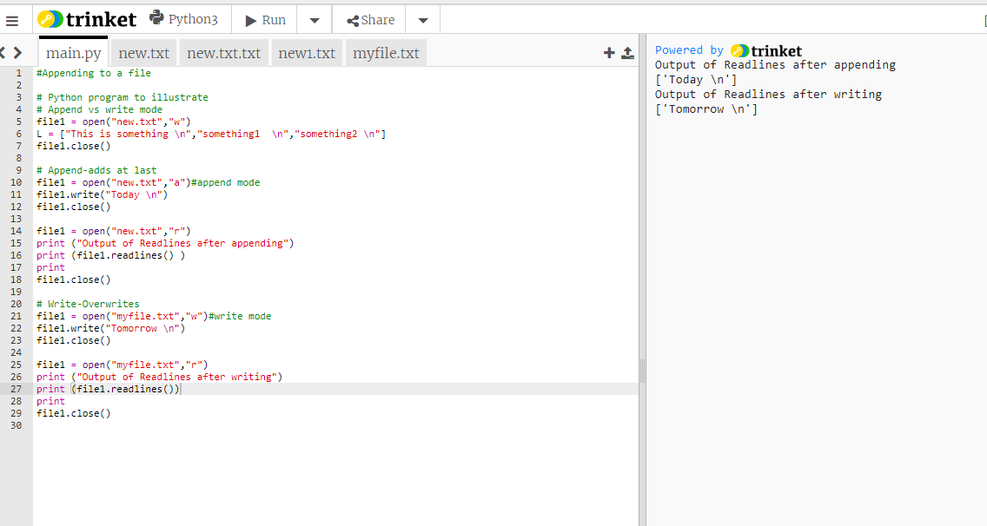
Appending to a file

